Slide 1
INCLASS EXERCISE COSC471
AHMED MUHAMMAD

Slide 2
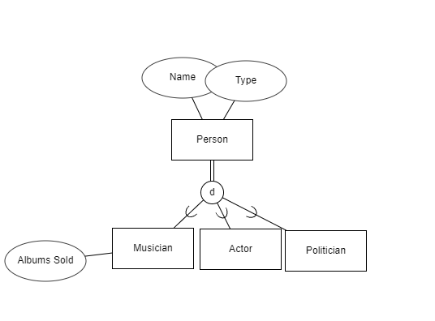
1.
I used erdplus.com to create this, and they represent the superclass/subclass with the circle d notation…

Slide 3
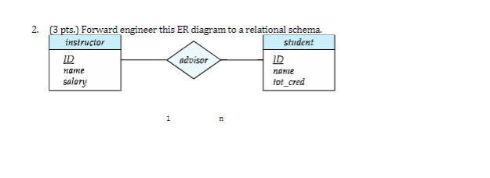
2.
Instructor(ID, Fname, Lname, Salary)
Student(ID, Fname, Lname, tot_cred, AdvisorID)

Slide 4
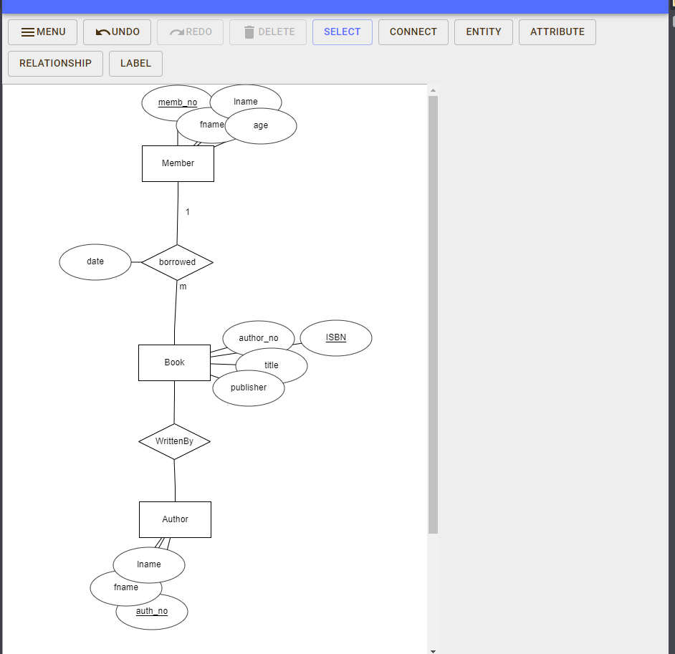
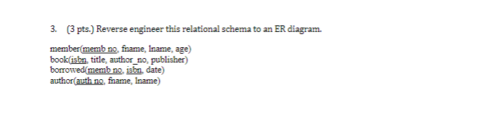
3).

